Slide 1


Load Balancer Using Docker Images
Verizon Connect – Big Data Engineer
Gautam Shanbhag

Slide 2
Contents :
Problem Statement
Prerequisites / Tools Required
Description
Proposed Approach
Step by Step Process
Output
Problems Faced
Learning
Reference

Slide 3
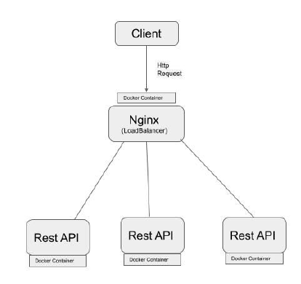
Problem Statement :
Create Load Balancer Using multiple Docker Containers
Nginx to act as a Load Balancer (round –robin algo) in one docker container
3 Spring boot java application hosted on individual docker containers to serve as backend servers
Spring boot application to return machine ip:port and hostname

Slide 4
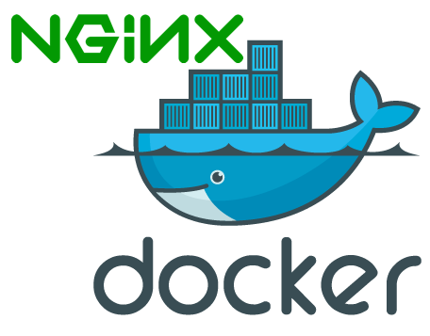
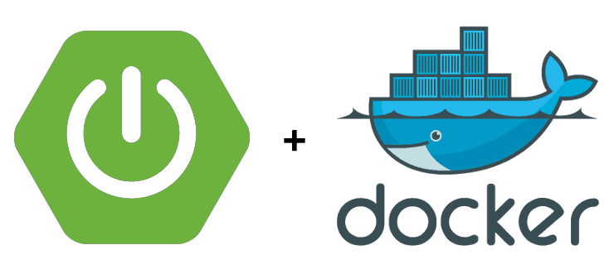
Prerequisites / Tools Required :
Docker
Nginx
Spring boot application built on Eclipse / Intelli J

Slide 5
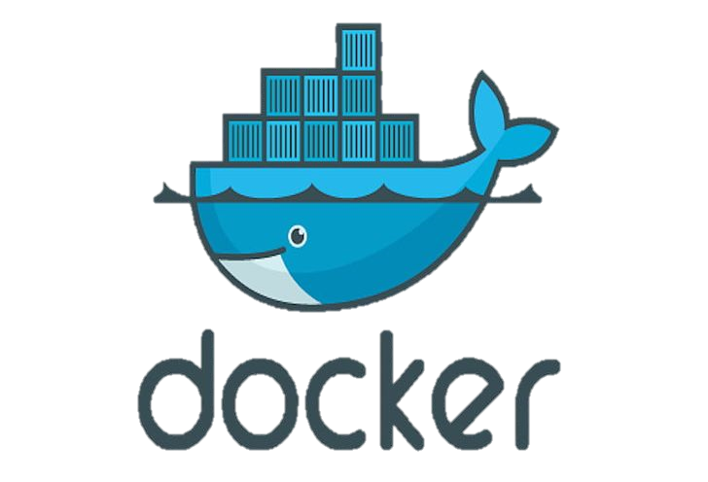


Description :
Docker is a set of platform-as-a-service products that use OS-level virtualization to deliver software in packages called containers. Containers are isolated from one another and bundle their own software, libraries and configuration files; they can communicate with each other through well-defined channels.
Nginx is a web server which can also be used as a reverse proxy, load balancer, mail proxy and HTTP cache.
Spring Boot is an open source Java-based framework used to create a Micro Service. It is easy to create a stand-alone and production ready spring applications using Spring Boot.

Slide 6
Proposed Approach :
Create a Spring boot rest application which returns machine ip and host name on api call
Start nginx standalone server with load balancer configuration
Test connection between sprint boot application and nginx
Use docker to create individual docker images for spring boot application
Use docker to create nginx image and copy local nginx configuration to the docker image
Use docker-compose.yml to establish communication between the 4 docker images

Slide 7
Step By Step Process :
Installation of Docker
https://docs.docker.com/docker-for-windows/install/
Spring Boot Application
Create a spring boot application using
https://start.spring.io/
Use favorable editor (eclipse / IntelliJ)to open the spring boot app
Create a Simple Class with Rest Mapping which would read the host machine’s ip port and hostname
Build java jar using maven commands (maven clean install)

Slide 8
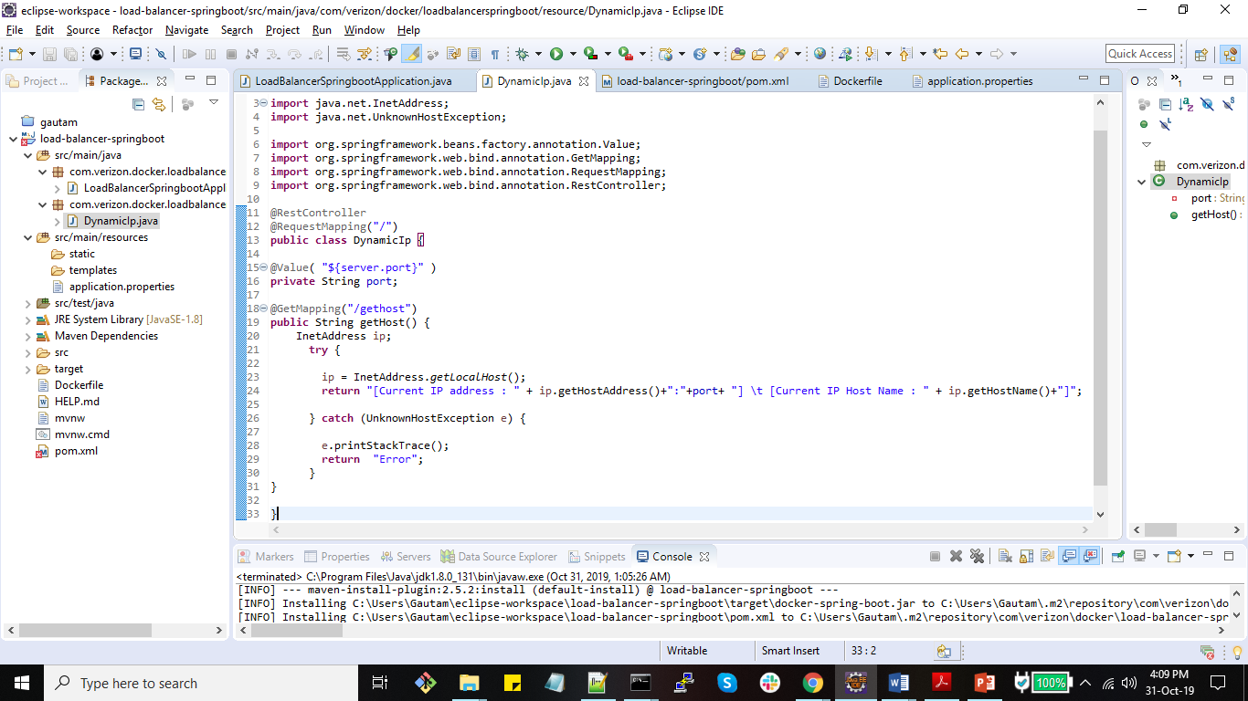
8

Slide 9
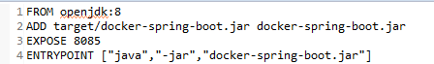
Create a Dockerfile in the repository
Build Docker images using the Dockerfile
This will download base java image from docker hub
Copy the spring boot jar from host machine to docker image
Expose docker port 8085 for external use
And run the java jar using “java –jar {jar_name}”
docker build -f Dockerfile -t verizon-springboot-1 .

Slide 10
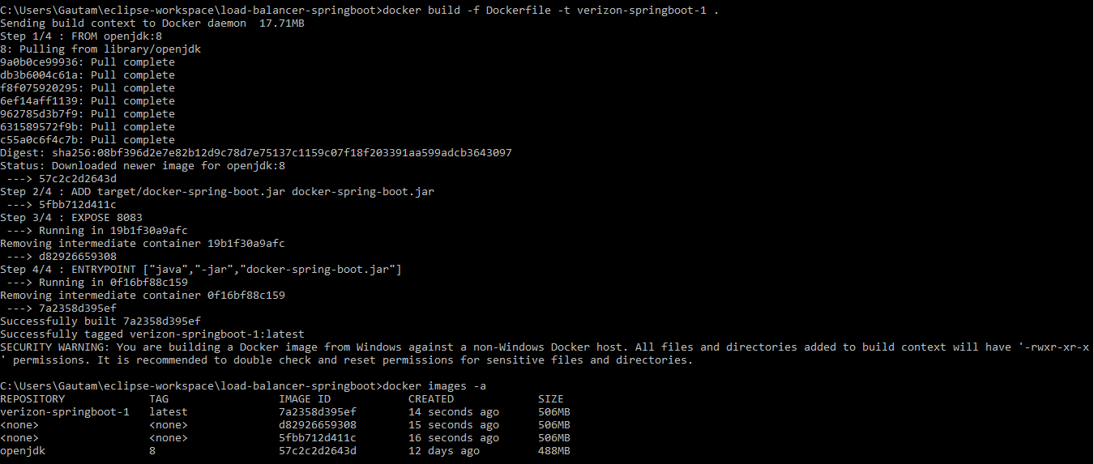

Slide 11
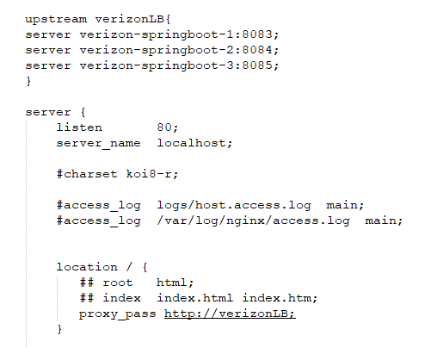

Similarly create 2 more docker spring boot images to serve as backend server by simply changing image names
change ports if required
Nginx Configuration
Install nginx on local server and modify nginx.conf to setup load balancer
Nginx supports 3 types of load balancing mechanism
Round-robin (default)
Least-connected
Ip-hash
Proper logging format when using load balancer

Slide 12

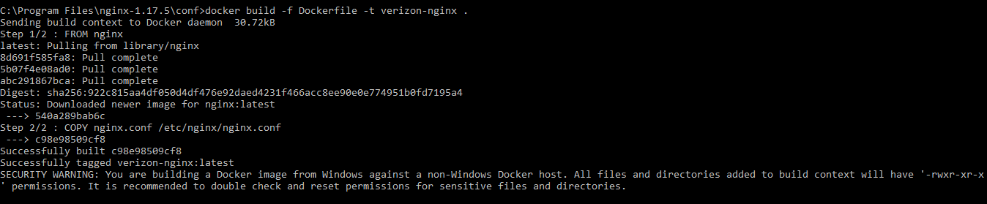
Create a nginx Dockerfile in the conf repository
Build Docker images using the Dockerfile
This will download base nginx image from docker hub
Copy/replace the nginx.conf file in linux docker environment at etc/nginx/nginx.conf
docker build -f Dockerfile -t verizon-nginx .

Slide 13
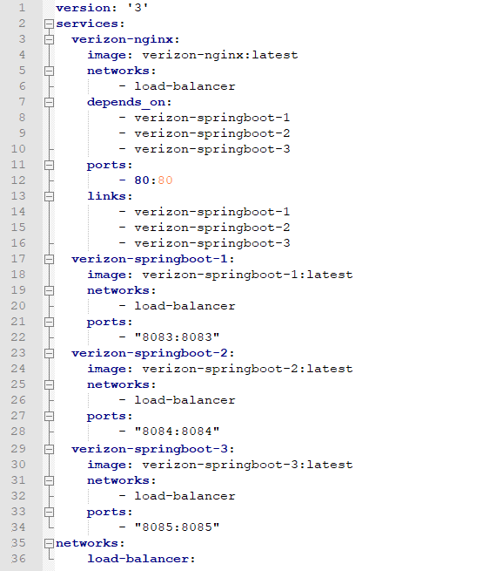
Create a docker-compose.yaml file
docker-compose.yaml
Creates Services Verizon-nginx, Verizon-springboot-1, Verizon-springboot-2, Verizon-springboot-3
Verizon nginx depends on the other 3 containers and will be built at the end
External ports are exposed
Verizon-nginx are linked to spring boot applications so that it can communicate with external resources
All services are bundled in a single load-balancer network

Slide 14
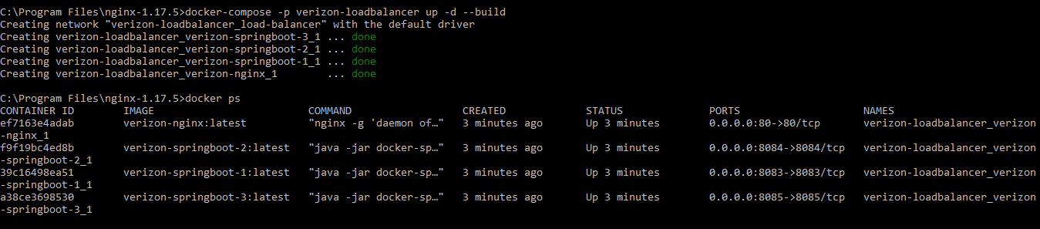
Build and run docker-compose.yml file using
docker-compose -p verizon-loadbalancer up -d –build
Check running docker states using
docker ps
Stop docker images using
docker-compose verizon-loadbalancer down

Slide 15
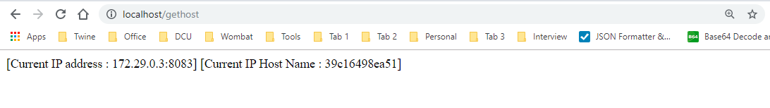
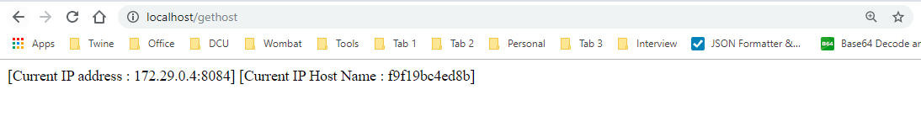
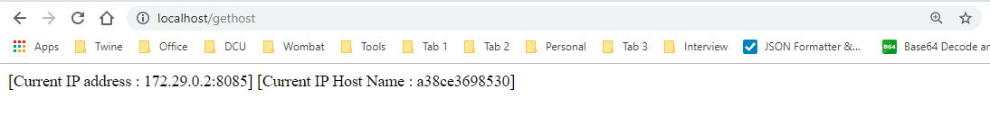
Output :

Slide 16
Problems Faced :
Connecting docker images to communicate with each other
Copying nginx.conf contents from windows machine to linux vm and starting nginx server
Debugging into docker containers to view logs
Portability - Deploying / sharing docker images
Learnings :
Understanding nginx
Load-balancing using nginx
Docker from scratch
Docker configurations and commands

Slide 17
References :
https://docs.docker.com/docker-for-windows/install/
https://www.youtube.com/watch?v=FlSup_eelYE
https://hostry.com/blog/nginx-configuration-of-a-simple-load-balancing/
https://www.youtube.com/watch?v=4ZHhYQuzL2g/
http://nginx.org/en/docs/windows.html
https://docs.nginx.com/nginx/admin-guide/monitoring/logging/
https://serverfault.com/questions/842423/how-to-completely-kill-nginx-in-windows
https://medium.com/@nirgn/load-balancing-applications-with-haproxy-and-docker-d719b7c5b231
https://www.callicoder.com/spring-boot-mysql-react-docker-compose-example/
https://forums.docker.com/t/nginx-getting-proxy-pass-to-work/32889
https://medium.com/@ainaleke/spinning-up-and-managing-multi-container-apps-using-docker-compose-d0d9f1e4d8ae
https://hackernoon.com/docker-commands-the-ultimate-cheat-sheet-994ac78e2888
https://phase2.github.io/devtools/common-tasks/ssh-into-a-container/
https://www.mkyong.com/java/how-to-get-ip-address-in-java/
https://runnable.com/docker/rails/manage-share-docker-images
http://blog.thoward37.me/articles/where-are-docker-images-stored/
https://www.baeldung.com/properties-with-spring
https://docs.docker.com/compose/reference/overview/
https://medium.com/elements/docker-application-packages-83c141d8cb0f

Slide 18
THANK YOU

